Slide 1
Social Dispersed Computing Applications, Challenges and Opportunities
Abhishek Dubey
Assistant Professor,
Computer Science and Electrical Engineering
Vanderbilt University
Senior Research Scientist,
Institute for Software Integrated Systems

Slide 2
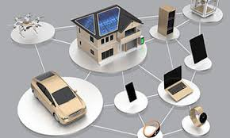
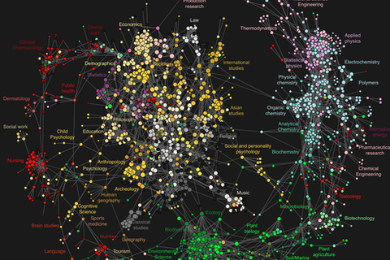
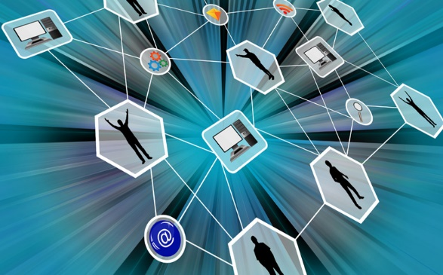
Outline of this talk
We are going to review the application domain of data-driven smart and connected cyber-physical systems.
Networked And Distributed Systems
Data Sciences
Social Sciences and Game Theory
These class of systems brings together the three different disciplines of engineering.

Slide 3
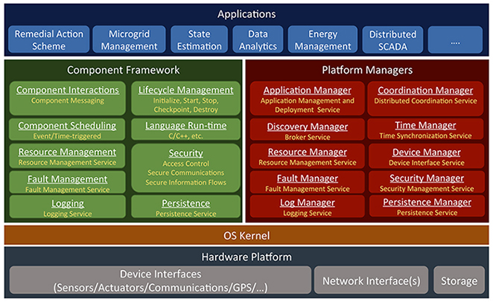
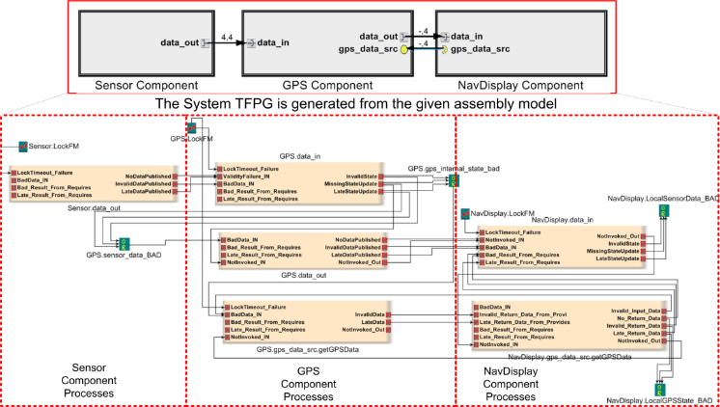
Outline of this talk
We are going to review the application domain of data-driven smart and connected cyber-physical systems.
We are going to focus on the area of distributed and networked systems and identify the key research challenges and new contributions.
New programming models and middleware
Fault Modeling and Diagnosis
Decentralized
Coordination

Slide 4
The emerging trend of decentralized societal-scale Cyber-physical Systems

Slide 5
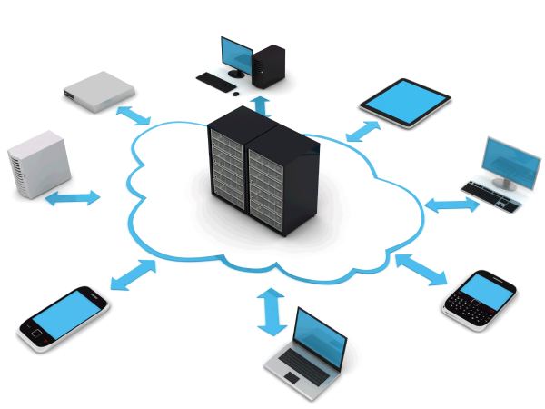

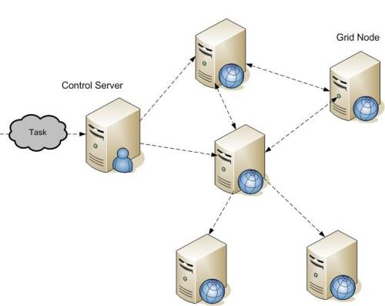
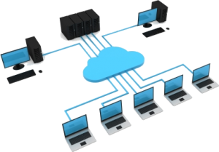
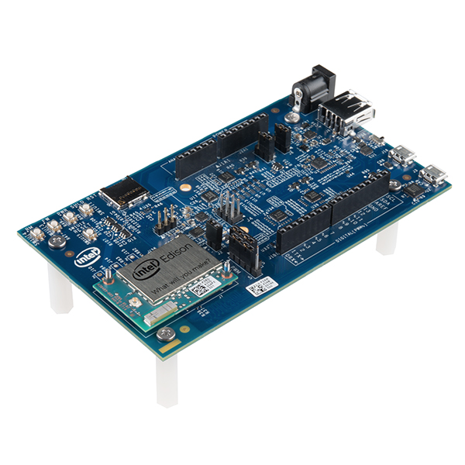
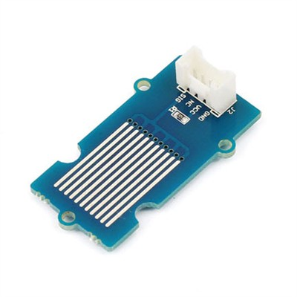
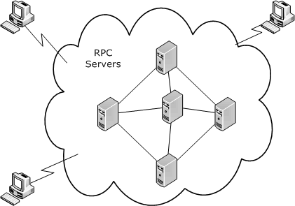
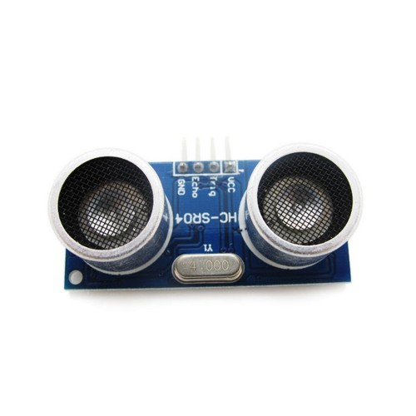
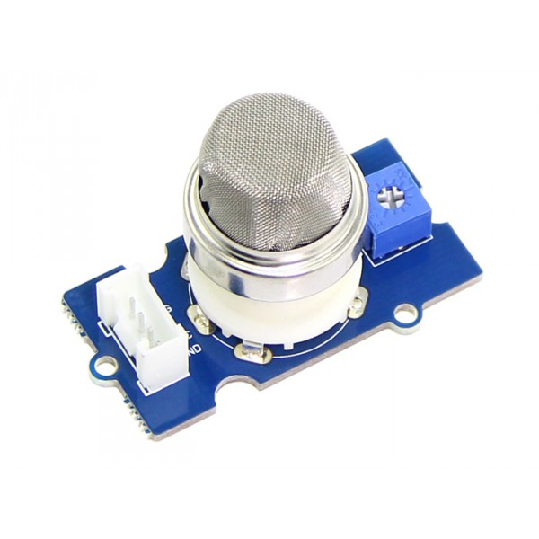
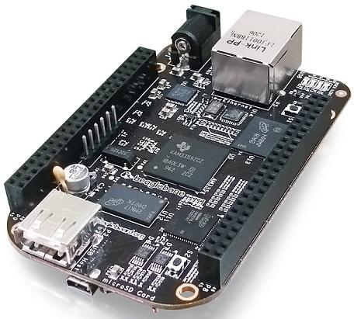
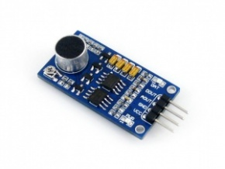
The impact of changing computing trends
Ubiquitous Computing (mobile, IoT, IIoT)
Grid Computing
Decentralized Computing
Present
Late 2000s
Single Board Computers
Mid 2000s
Mid 1990s
Cloud Computing
Small Homogeneous Clusters
Notes:
IoT/IIoT: Devices that are connected to each other and connected to the Internet
Emerging trends: Advancement in edge computing devices have resulted in sophisticated and resourceful devices that are equipped with variety of sensors and actuators
E.g.: Intel Edison on Arduino with sensors from the Grove Starter Kit
Therefore, the future of Ubiquitous Computing is CP in nature. As such CPS will play an important role.
Smart cities are great exemplars of future of ubiquitous computing:
Comprises heterogeneous resources of varying domains (transportation, power grid, e.t.c..)
Resources vary from resc-constd edge devices with sensors/actuators to resourceful cloud instances
Resources can be dynamic and have distributed ownership
As such, traditional notion of CPS does not fit as is

Slide 6
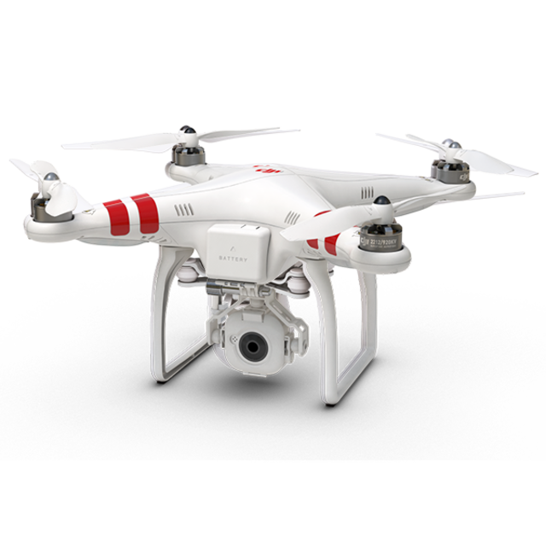
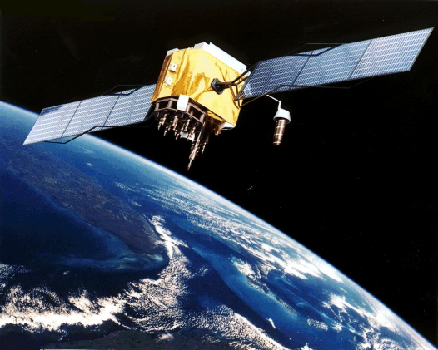
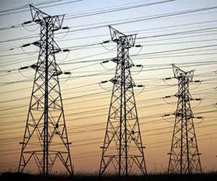
Changing Computing Trend -> CPS to Decentralized CPS
CPS= Computation Software + Physical system + Networks+ Coordinated + Closed-loop
The emphasis is on models and control loops designed using those models.

Slide 7
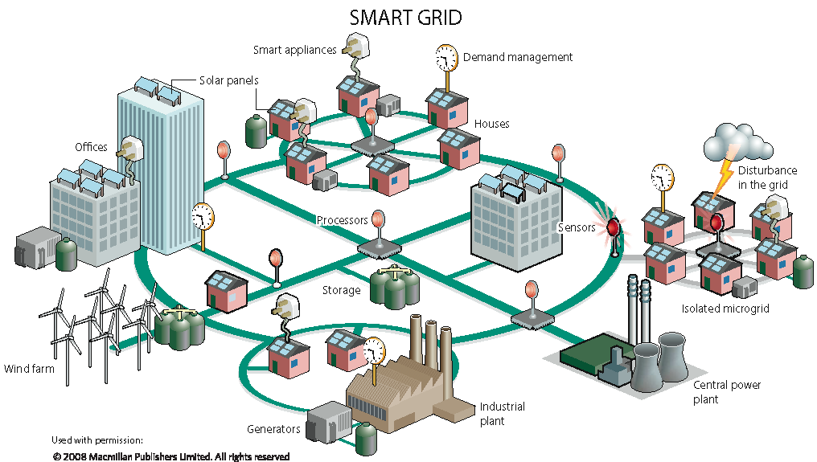
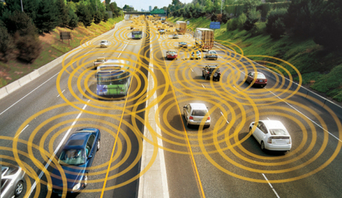

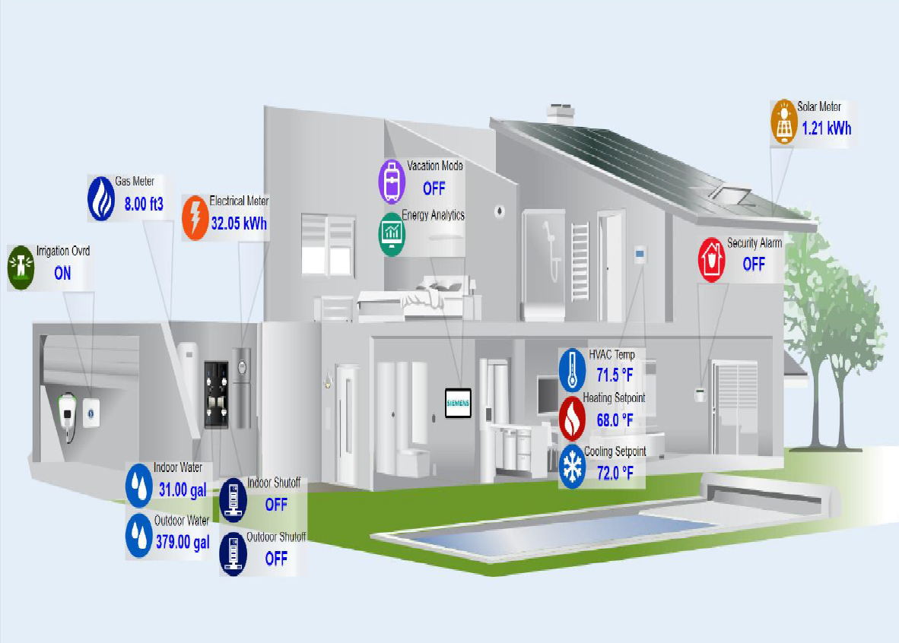
Changing Computing Trend -> CPS to Decentralized CPS
Microgrids
Transportation on
Health Care
Smart Buildings
Decentralized CPS are a generalization of Internet of Things (IoT)
CPS= Computation Software + Physical system + Networks+ Coordinated + Closed-loop
Notes:
Each provider and each senior living center has their own information – what if people keep the information in their control – can keep control.

Slide 8
Changing Computing Trend -> CPS to Decentralized CPS
Unlike classical CPS this new trend of decentralized CPS is built on integration of three research disciplines.
Networked And Distributed Systems
Data Sciences
Social Sciences and Game Theory

Slide 9
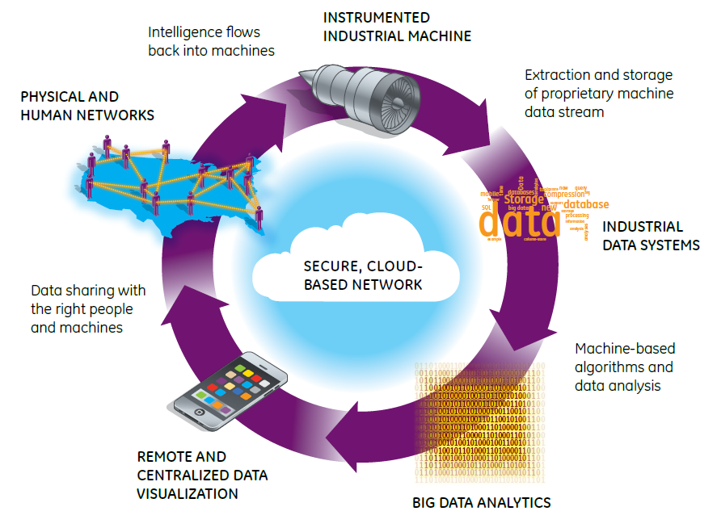

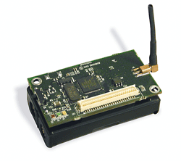
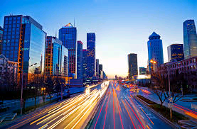
Changing Computing Trend -> CPS to Decentralized CPS
Human Layer
Cities
Sensors
Smart Application Layer
Computation Platform Layer
Networking Layer
Physical System and Sensors

Slide 10
Changing Computing Trend -> CPS to Decentralized CPS
Human Layer
Cities
Sensors
Data Streams
Smart Application Layer
Computation Platform Layer
Platform
Networking Layer
Physical System and Sensors

Slide 11
Changing Computing Trend -> CPS to Decentralized CPS
Human Layer
Cities
Sensors
Data Streams
Smart Application Layer
Decision Support Systems
Platform
Networking Layer
Physical System and Sensors
Decision Support Systems: Big Data Analytics

Slide 12
Changing Computing Trend -> CPS to Decentralized CPS
Human Layer
Cities
Sensors
Data Streams
Smart Application Layer
Decision Support Systems
Platform
Networking Layer
Physical System and Sensors
UI and Information Presentation
Decision Support Systems: Big Data Analytics

Slide 13
Changing Computing Trend -> CPS to Decentralized CPS
Human Layer
Cities
Sensors
Human Networks
Data Streams
Smart Application Layer
Decision Support Systems
Data Sharing
Platform
Networking Layer
Physical System and Sensors
UI and Information Presentation
Decision Support Systems: Big Data Analytics

Slide 14
Let us consider an example

Slide 15
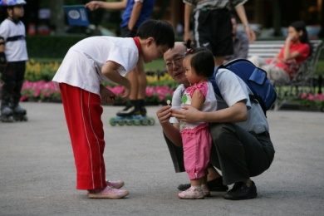

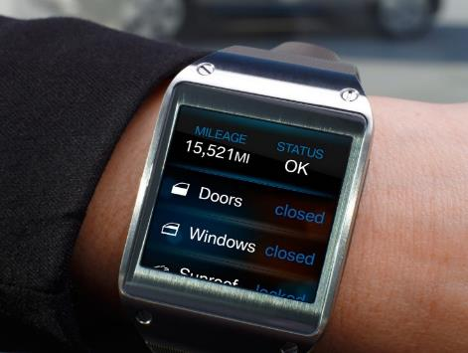
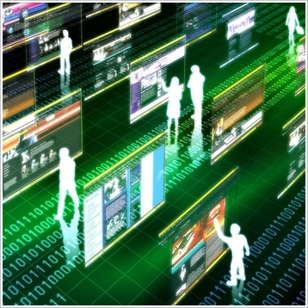
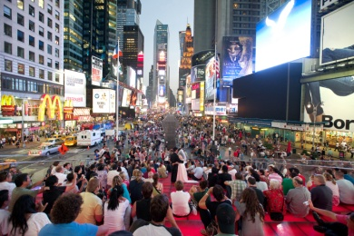
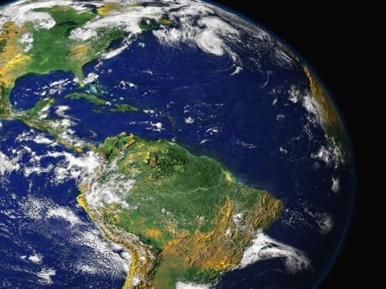
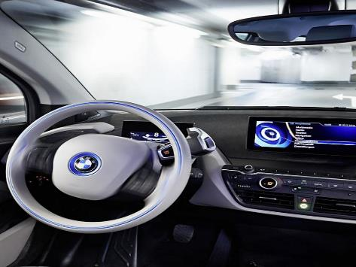

The world is changing – digitalization and automation are the new enablers
MEGATRENDS
DIGITALIZATION
DEMOGRAPHIC CHANGE
CLIMATE CHANGE
ALWAYS ON
SHOPPING
URBANIZATION
GLOBALIZATION
SHARING ECONOMY
AUTONOMOUS DRIVING
Notes:
Gautam

Slide 16
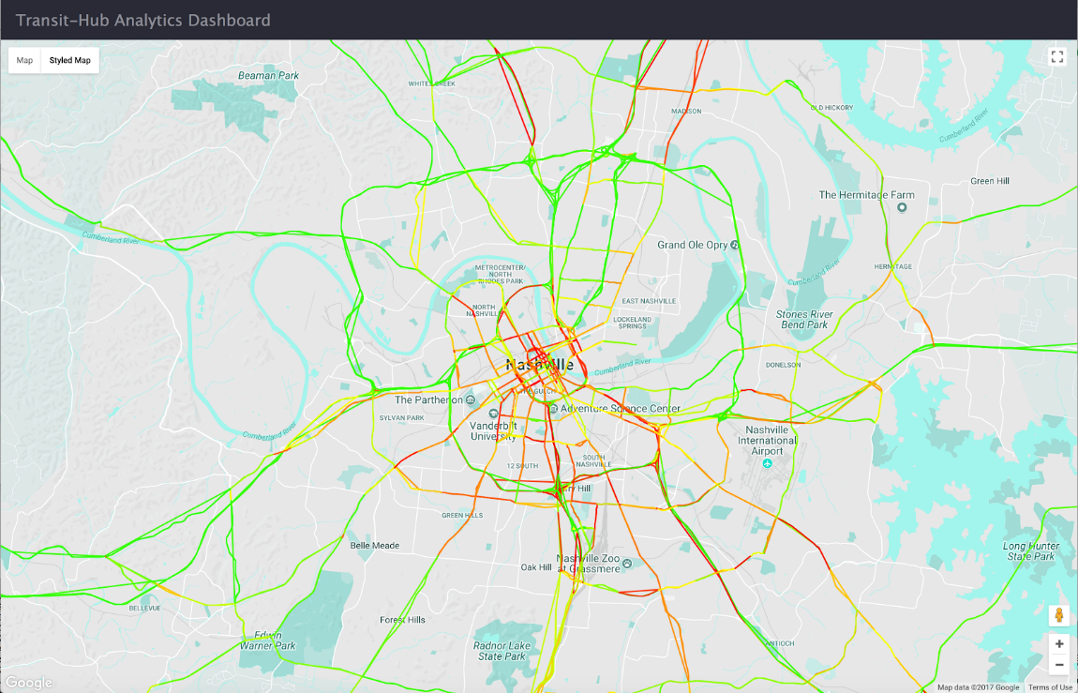
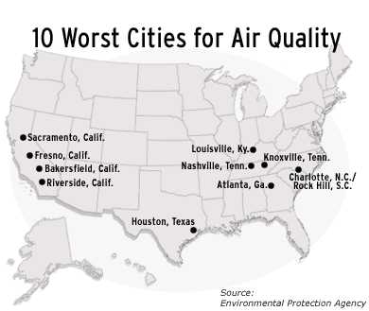
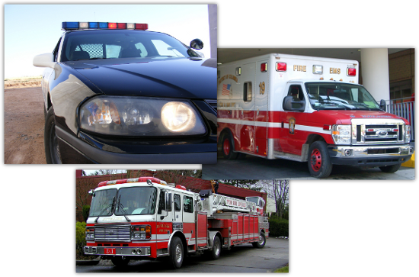

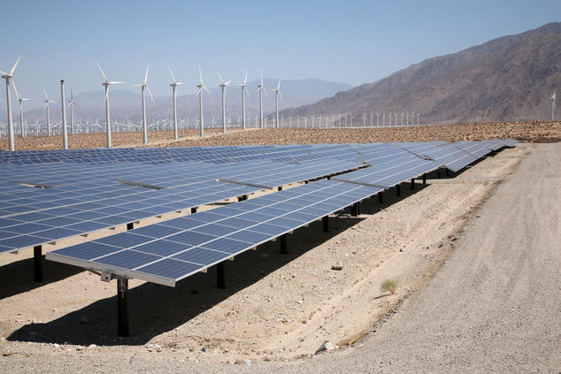

An you can see the impact across domains
Transporation
Infrastructure
Safety
marylandassociationofcounties
Energy
Industrial Automation
Digital Manufacturing
Notes:
Gautam

Slide 17
Lets look at some examples

Slide 18
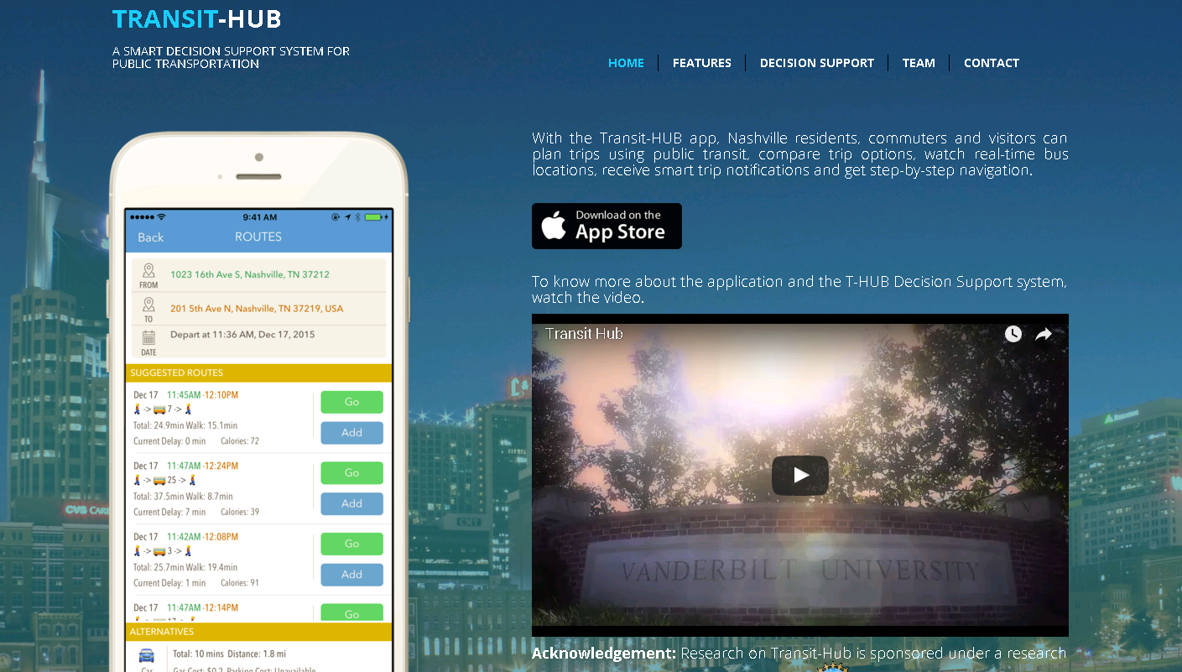

Slide 19
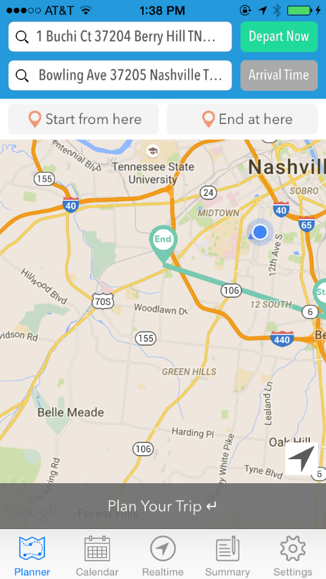
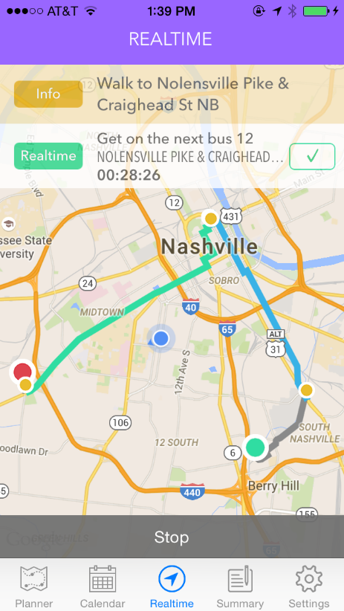
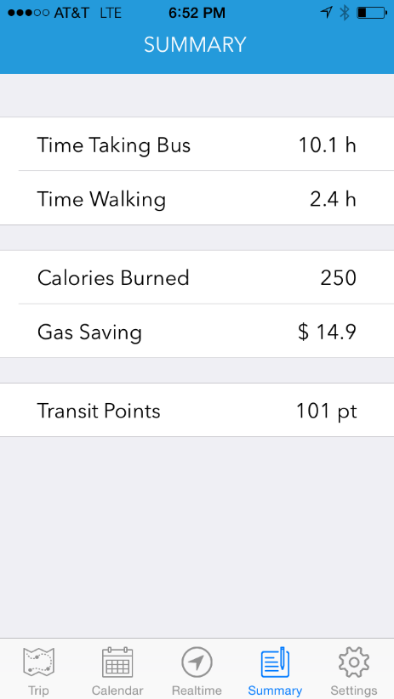
Transit-Hub Frontend
Trip Planning
Real-Time View
Information as incentives

Slide 20



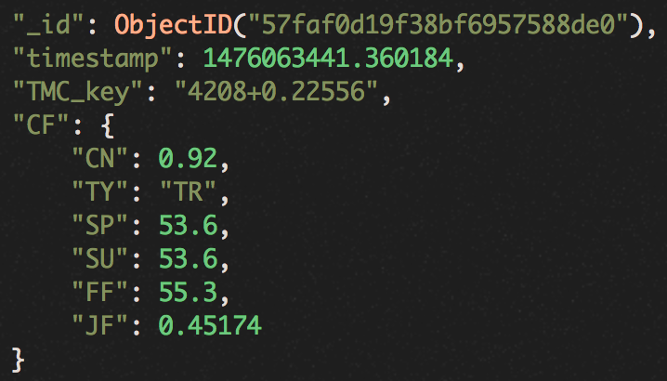

Example: A Transportation Application
Data Aggregation
Contextual Anomaly Detection
Applications and Services
Smart
Phones
Data Formatting
Converting to the same format
Long-term Model
Stacked Convolutional Neural Networks
Explaining non-recurrent traffic patterns for large areas
Real-time Delay Prediction
For visitors and travelers
Data Cleaning
Get rid of errors and noises
Augmented Traffic Dataset
For third party applications
Roadside
Sensors
Data Processing
Normalization
Balancing
Aggregation
Short-term Model
Stacked LSTM encoder decoder
Identifying traffic anomaly due to events, e.g., accidents
Predicting traffic conditions
Service Alerts
For visitors and travelers
On-vehicle
Devices
Service Analysis and Optimization
For city planners
Traffic
Data APIs

Slide 21
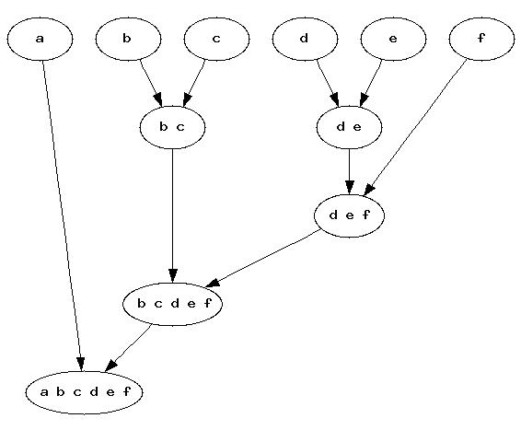
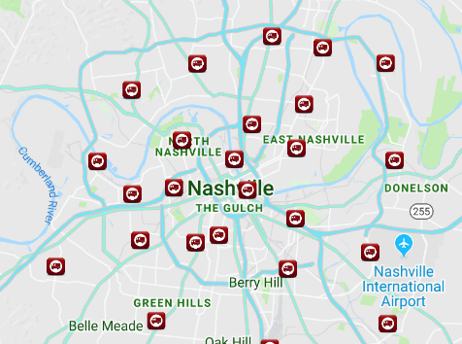
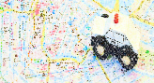
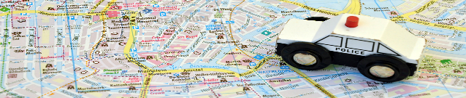
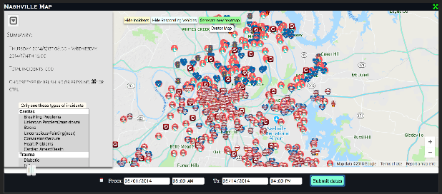
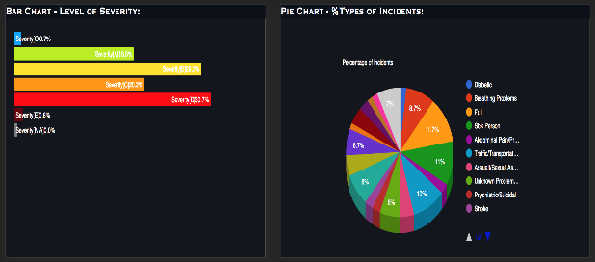
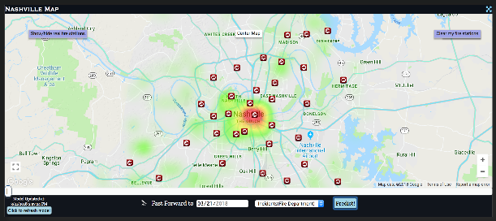
A Safety Application: Incident Prediction & Emergency Responder Dispatch
Time
Predict Incidents
Clustered Survival Models
Place Responders
Response Optimization of Coverage
Dispatch Responders
Decision Theoretic Frameworks
Simplified State
Representation
Iteratively cluster spatial regions.
Learn time to event distributions.
Maximize coverage.
Limit Wait Time.
Greedy Adaptive Heuristic Search.
Semi Markovian Representation.
Heuristic-Seeded Policy Iteration.
Visualization and Analytics Tool
Spatial Incident Plot
Real-Time Analytics
Future Prediction

Slide 22
An Energy Application
Data Aggregation
Contextual Anomaly Detection
Applications and Services
Smart
Phones
Data Formatting
Converting to the same format
Long-term Model
Stacked Convolutional Neural Networks
Explaining non-recurrent traffic patterns for large areas
Real-time Delay Prediction
For visitors and travelers
Data Cleaning
Get rid of errors and noises
Augmented Traffic Dataset
For third party applications
Roadside
Sensors
Data Processing
Normalization
Balancing
Aggregation
Short-term Model
Stacked LSTM encoder decoder
Identifying traffic anomaly due to events, e.g., accidents
Predicting traffic conditions
Service Alerts
For visitors and travelers
On-vehicle
Devices
Service Analysis and Optimization
For city planners
Traffic
Data APIs

Slide 23
What is the common element across these different Applications.

Slide 24
Human Layer
Cities
Sensors
Smart Application Layer
Computation Platform Layer
Networking Layer
Physical System and Sensors

Slide 25
Human Layer
Cities
Sensors
Data Streams
Smart Application Layer
Computation Platform Layer
Platform
Networking Layer
Physical System and Sensors

Slide 26
Human Layer
Cities
Sensors
Data Streams
Smart Application Layer
Decision Support Systems
Platform
Networking Layer
Physical System and Sensors
Decision Support Systems: Big Data Analytics

Slide 27
Human Layer
Cities
Sensors
Data Streams
Smart Application Layer
Decision Support Systems
Platform
Networking Layer
Physical System and Sensors
UI and Information Presentation
Decision Support Systems: Big Data Analytics

Slide 28
Human Layer
Cities
Sensors
Human Networks
Data Streams
Smart Application Layer
Decision Support Systems
Data Sharing
Platform
Networking Layer
Physical System and Sensors
UI and Information Presentation
Decision Support Systems: Big Data Analytics

Slide 29
How did we get here?

Slide 30
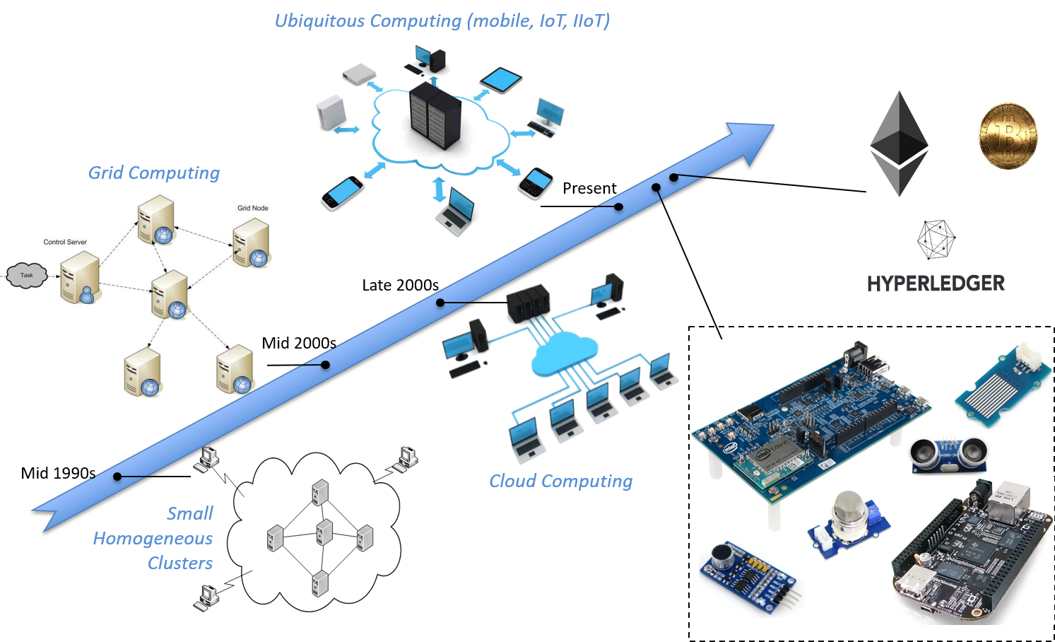
The Computing Evolution

Slide 31
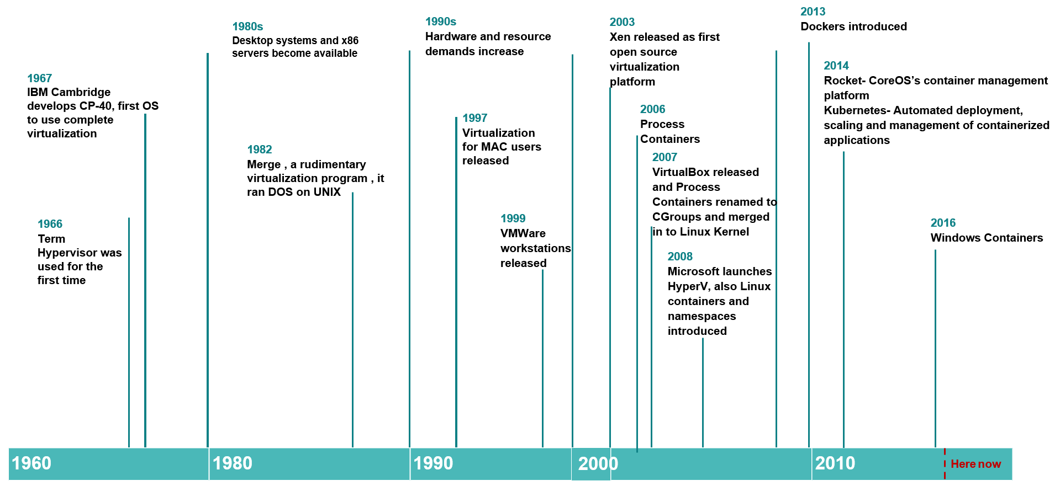
Virtualization and Containerization is a key concept

Slide 32
What are the key requirements
The
Cities
Sensors
Human Networks
Data Streams
Data Sharing
Platform
UI and Information Presentation
Decision Support Systems: Big Data Analytics

Slide 33

Looking to the Future:
Societal Scale cyber-physical system applications will be driven by massively connected and distributed devices across the globe.
However, massively distributed across heterogeneous devices with varying levels of trust.
Advantage: A resilient and redundant computation surface close to the physical process under control

Slide 34
What are the main challenges in these systems?

Slide 36
How did we get here?

Slide 37
Societal Scale Cyber-Physical Systems

Slide 38
Outline
A brief history of
A
Decentralization: The point of inflection
Social Dispersed Computing = Decentralization+Cyber-

Slide 39
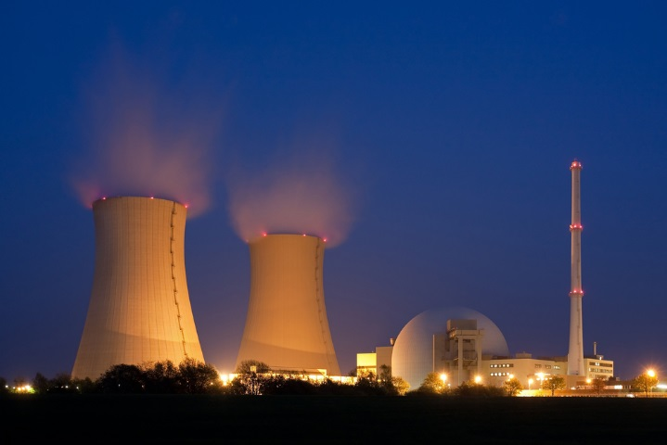
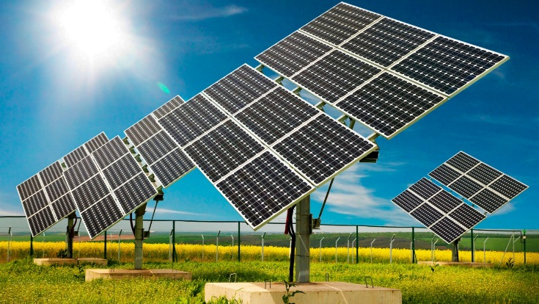
Electrical Energy Networks are Changing
From centralized to decentralized and distributed energy systems
Changing Generation Mix
Transactive Energy
Electric Cars
Decentralization
DER-s
Increasing Complexity

Slide 40

The Evolution of Energy Networks
Traditional networks with transmission system operators, distribution system operators, and radial distribution systems to communities

Slide 41
The Evolution of Energy Networks
Advantages of decentralization
improved cyber and physical reliability by removing single point of failures
faster decision making by avoiding network penalties due to round-trip to the cloud
improved scalability
better integration with hierarchical control systems
Traditional networks with transmission system operators, distribution system operators, and radial distribution systems to communities
Network of distribution feeders with some microgrids with tightly integrated distributed energy resources

Slide 42
The Evolution of Energy Networks
Trend
Traditional networks with transmission system operators, distribution system operators, and radial distribution systems to communities
Network of distribution feeders with some microgrids with tightly integrated distributed energy resources
Network of transactive microgrids with limited role of distribution system operators

Slide 43

However, the Information Architecture is Still Centralized
Communication Network
Centralized SCADA supports utility companies

Slide 44
However, the Information Architecture is Still Centralized
Communication Network
Problems
Integration challenge
Reliability issues
Management issues

Slide 45
Resilient Information Architecture Platform

Slide 46


Application Programming Interfaces
Decentralized
Distributed
Sensing
Analysis
Control Applications

Slide 47




Application Programming Interfaces
Hardware Assisted High Precision Networked Time Synchronization
GPS/PTP/NTP

Slide 48


Distributed Fault Management Framework
Robust Development and Operation Framework

Slide 49
Example Application

Slide 50

Transactive Energy
Participant 1
Energy Exchange
Reduces Dependence on the Grid
Participant 2
typical generation and consumption profile

Slide 51

Transactive Energy System (Example Application)
We have developed PETra, a blockchain-based solution that enables consumers to trade energy without sacrificing their privacy and provides safety and security for the grid. It provides the following:
The node runs the necessary logic to participate in the trading
A RIAPS Node Participating in PETra-Enabled Transactive Energy Market

Slide 52
Summary
Reliability of our grid and electrical system depends upon the ability to operate as a collection of Microgrids
This requires sensing, control and actuation throughout the system.
Centralized computing will not be enough and therefore fog computing is an answer.
RIAPS provides the key building blocks required to build the applications.
However, more applications need to be constructed.
Visit http://riaps.isis.vanderbilt.edu to learn more
Network of transactive microgrids with limited role of distribution system operators

